Slide 1
Sensor Web
Group: Dec1713
Advisor: Dr. Geiger
Members: Tim Lindquist, Steve Warren, Gregory Steenhagen, Ian Harris, Terver Ubwa, Khoi Cao
Notes:
Tim: Introduce ourselves

Slide 2
Overview
Project Plan
Project Statement
Background
Requirements/Constraints
System Overview
Group Breakdown
Timeline
System Design
Design
Operational Node
Home Node
Web Application
Testing
Node System Testing
Conclusion
Independent Assessment
Contributions & Roles
Questions
Notes:
Tim:

Slide 3
Project Plan
Notes:
Steve:

Slide 4
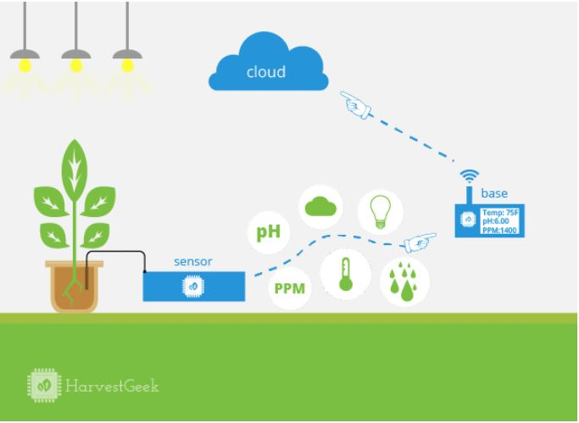
Project Statement
Project Plan:
Our project is to develop a cost effective network of nodes to relay sensor data across fields. This data will be sent to a 2G enabled home node which will upload the data to a web application for users to interface with.
Goal: Help farmer decide when to irrigate field.
HarvestGeek IoT model in farming
Notes:
Steve:

Slide 5
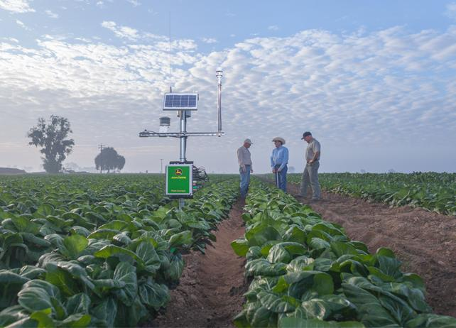
Background
Project Plan:
Currently, the only solutions for analyzing field moisture are unaffordable, $5k-10k annually. Our team’s solution will be considerably less expensive ($11 per module) and dispensable.
John Deere Field Connect system
Notes:
Steve: upkeep, installation, services, Prices will be explained more later.

Slide 6
Requirements / Constraints
Project Plan:
Requirements (functional):
Operational Nodes transmit and receive radio signals and data up to 208ft (1 acre)
Home Node receives radio data and transmits it via 2G to Web Application
Web Application hosts and displays data in intuitive fashion
Dedicated server with public access
Requirements (nonfunctional)
Spreadsheets
CAD drawings
Constraints:
System on a tight budget
Nodes must be dispensable
Optimize for minimal power consumption
Notes:
Charlie: Explain how we broke into 3 groups

Slide 7
System Overview
Project Plan:
Notes:
Tim: Operational Nodes: request for a node, data will be passed until node receives. Node will send out it’s data, other nodes will relay data until reaching the final node.

Slide 8
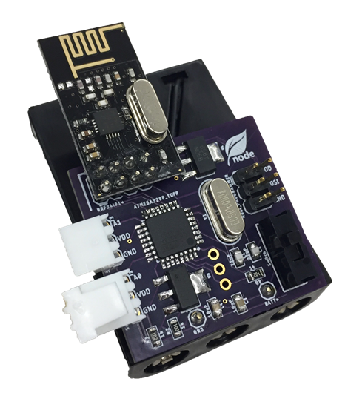
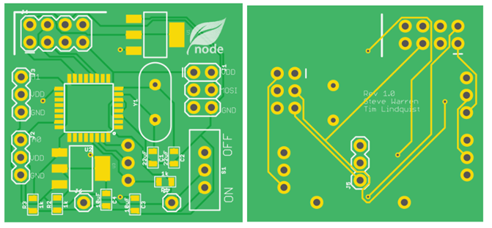
Operational Node
Project Plan:
Main Components:
Transceiver Radio Communication (NRF24l01)
ATMega328p Microcontroller
Design
Node Network
Printed Circuit Board
Power Efficient (7 months)
Individual Cost: $11
Operational Node & PCB
Notes:
Steve: http://www.microchip.com/wwwproducts/en/ATmega328P
https://arduino-info.wikispaces.com/Nrf24L01-2.4GHz-HowTo

Slide 9
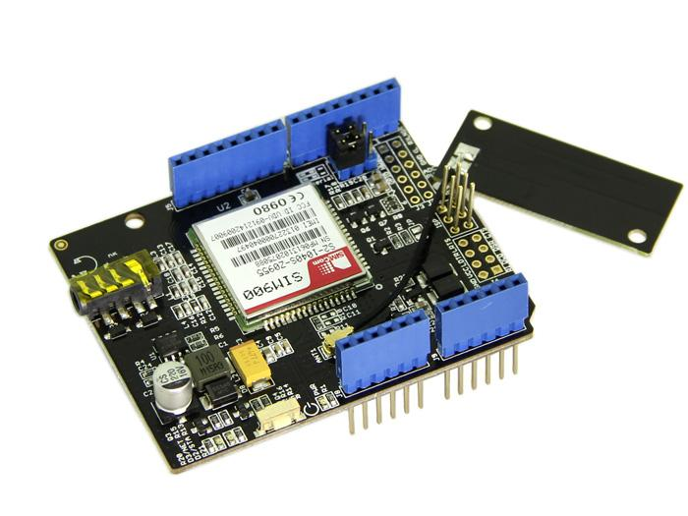
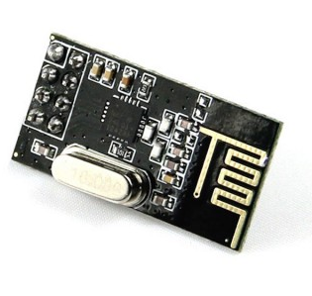
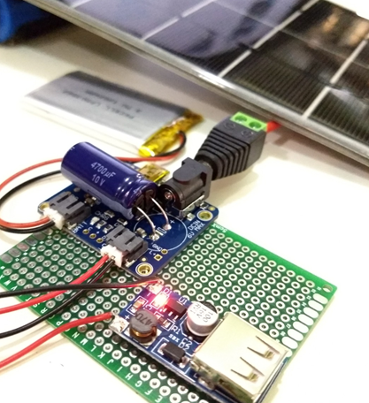
Home Node
Project Plan:
Main Components:
Arduino Uno
SIM 900A Shield
Long Range Radio Communication (NRF24l01)
Design
Cellular Network (2G)
Radio Reception between Home-Op Node
Power Supply
Cost: $40
SIM 900A Shield
NRF24l01-2.4GHz
Solar panel with smart charger
Notes:
Kacao: HN: middle gnd btw Op-Node and webapp for relaying sensors data to the cloud service
made of 2 main parts: radio transceiver and cellular-enabled transmitter.
- RF is designed with the an identical RF on Op-Node to avoid the compatibility issue. (figure 1)
- Long-distance communication btw Home Node to webserver can be established by the 2G sim (figure 2).
- The brain: Arduino Uno or mini which is easily setup < module might cause the data to be corrupted or lost. >
As the goal is making the system cheap, we want to design the power supply with reglar AA or Li-on battery.
The total expense is roughly 40-50
There is a concern for home station since 2G module eats up battery fast.
That problem can be resolved using solar power system we design (figure 3). However, it should be seen as a fancy alternative option
since it's overpriced.
Next, Ian continue web design.

Slide 10
Web Application
Project Plan:
Hosted on Redhat Linux Server
Space provided by Iowa State
REST API communicates with Home Node
Front-End application communicates with the user
Database stores information
Notes:
Ian:
Our web application is currently hosted on a Redhat Linux server provided to us by ETG here at Iowa State. To generalize our design, we have two part application with backend and frontend using different technologies. The back end provides a REST API that communicates with our home nodes and front end by exposing URL endpoints that send and receive data. The front end is a separate application that organizes information for our user, and allows them to claim nodes placed in their network. To store this information, we have a database to store our information.

Slide 11
Cumulative Timeline
Timeline:
Notes:
Ian:
Our timeline broken down into two semesters. The first semester, we spent most of our time creating our project plan and testing the feasibility of said plan. For our second semester, we mostly executed on that plan. At the end of the day, each team has a system that completes its goal, and we believe overall does a good job of answering our project statement.

Slide 12
System Design
Notes:
Tim:

Slide 13
Operational Node Network
System Design:
Wake & Measure
Notes:
CSMA/CA is similar to Ethernet. Not chosen because it would require more transmitting which uses too much power in our application

Slide 14
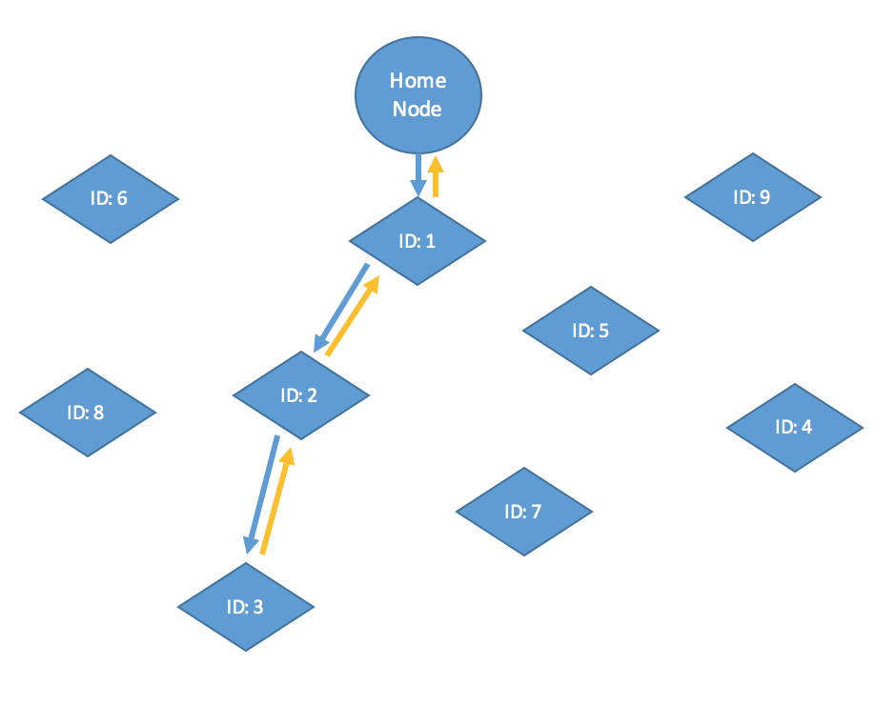
Operational Node Network
System Design:
Request Rx + Tx
Topographical View
Notes:
Steve say alternatives first. CSMA/CA

Slide 15
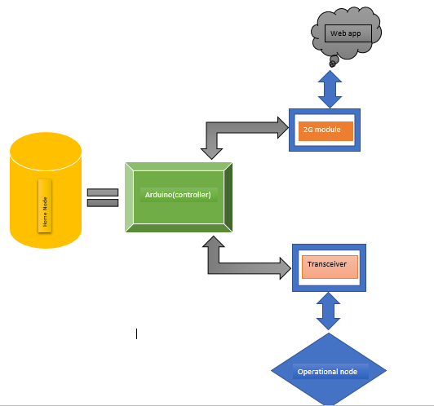
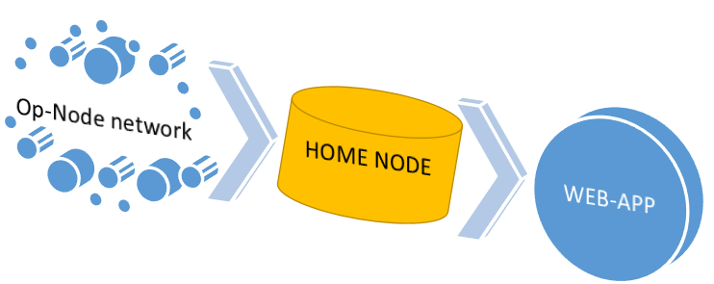
Home node Design
System block diagram
System Design:
Break-down Home Node design
Relaying data from sensors to web
Notes:
Terver: Has basically three components. The receiver/transmitter (transceiver) sends time value to set the operational nodes. The receiver/transmitter also receives the desired sensor data information. The processor (arduino) is the main power house. It controls both the 2G module and the transceiver. The 2G receives the path and also relays the received data to the web.

Slide 16
Web Application
System Design:
Spring Boot Application REST API
Provides REST endpoints
Laravel Framework MVC
SB Admin 2 Bootstrap template for the frontend
MySQL Database
http://sensorweb.ece.iastate.edu
Space provided by ETG
Notes:
Ian: Getting into the specifics of our web application, we again have two parts. We have a Spring Boot Application, which is a Java based web framework. The primary purpose of this application is to provide the business logic for our application, specifically running processes like calculating shortest paths and communicating with the database. On our front end, we have a Laravel MVC Framework which is a PHP based solution for delivering web pages, and populating them with information. For our web pages, we are using the SB Admin 2 Bootstrap template, which provided us with convenient features for graphing our data. Speaking of which, our information is stored in a simple MySQL database. Our application is hosted on a domain provided by ETG at Iowa State, and you can find it at Sensorweb.ece.iastate.edu

Slide 17
Shortest Path Calculations
System Design:
GPS Coordinates are provided via the frontend
An Adjacency map is created based on distance between nodes
The map is run through a Floyd-Warshall Algorithm
Shortest Paths are stored in the database
The home node requests shortest paths from REST API
Notes:
Ian: One of the primary functions of our backend was to calculate the paths from the home node to each operational node. We had explored using a more costly transfer protocol, but decided to do the extra work of calculating the paths so the operational nodes could spend more time in low-power mode. First, the GPS coordinates are provided to the front end of our web application as a user claims nodes. One this is complete, the user would trigger field configuration, where an adjacency map would be built for our shortest path algorithm. This is done simply by checking that the GPS coordinates are within 200 feet. The adjacency matrix is run through a Floyd Warshall Algorithm, from which the shortest path to each node can be extracted and stored. The end goal is to have our home node retrieve these paths via our REST api

Slide 18
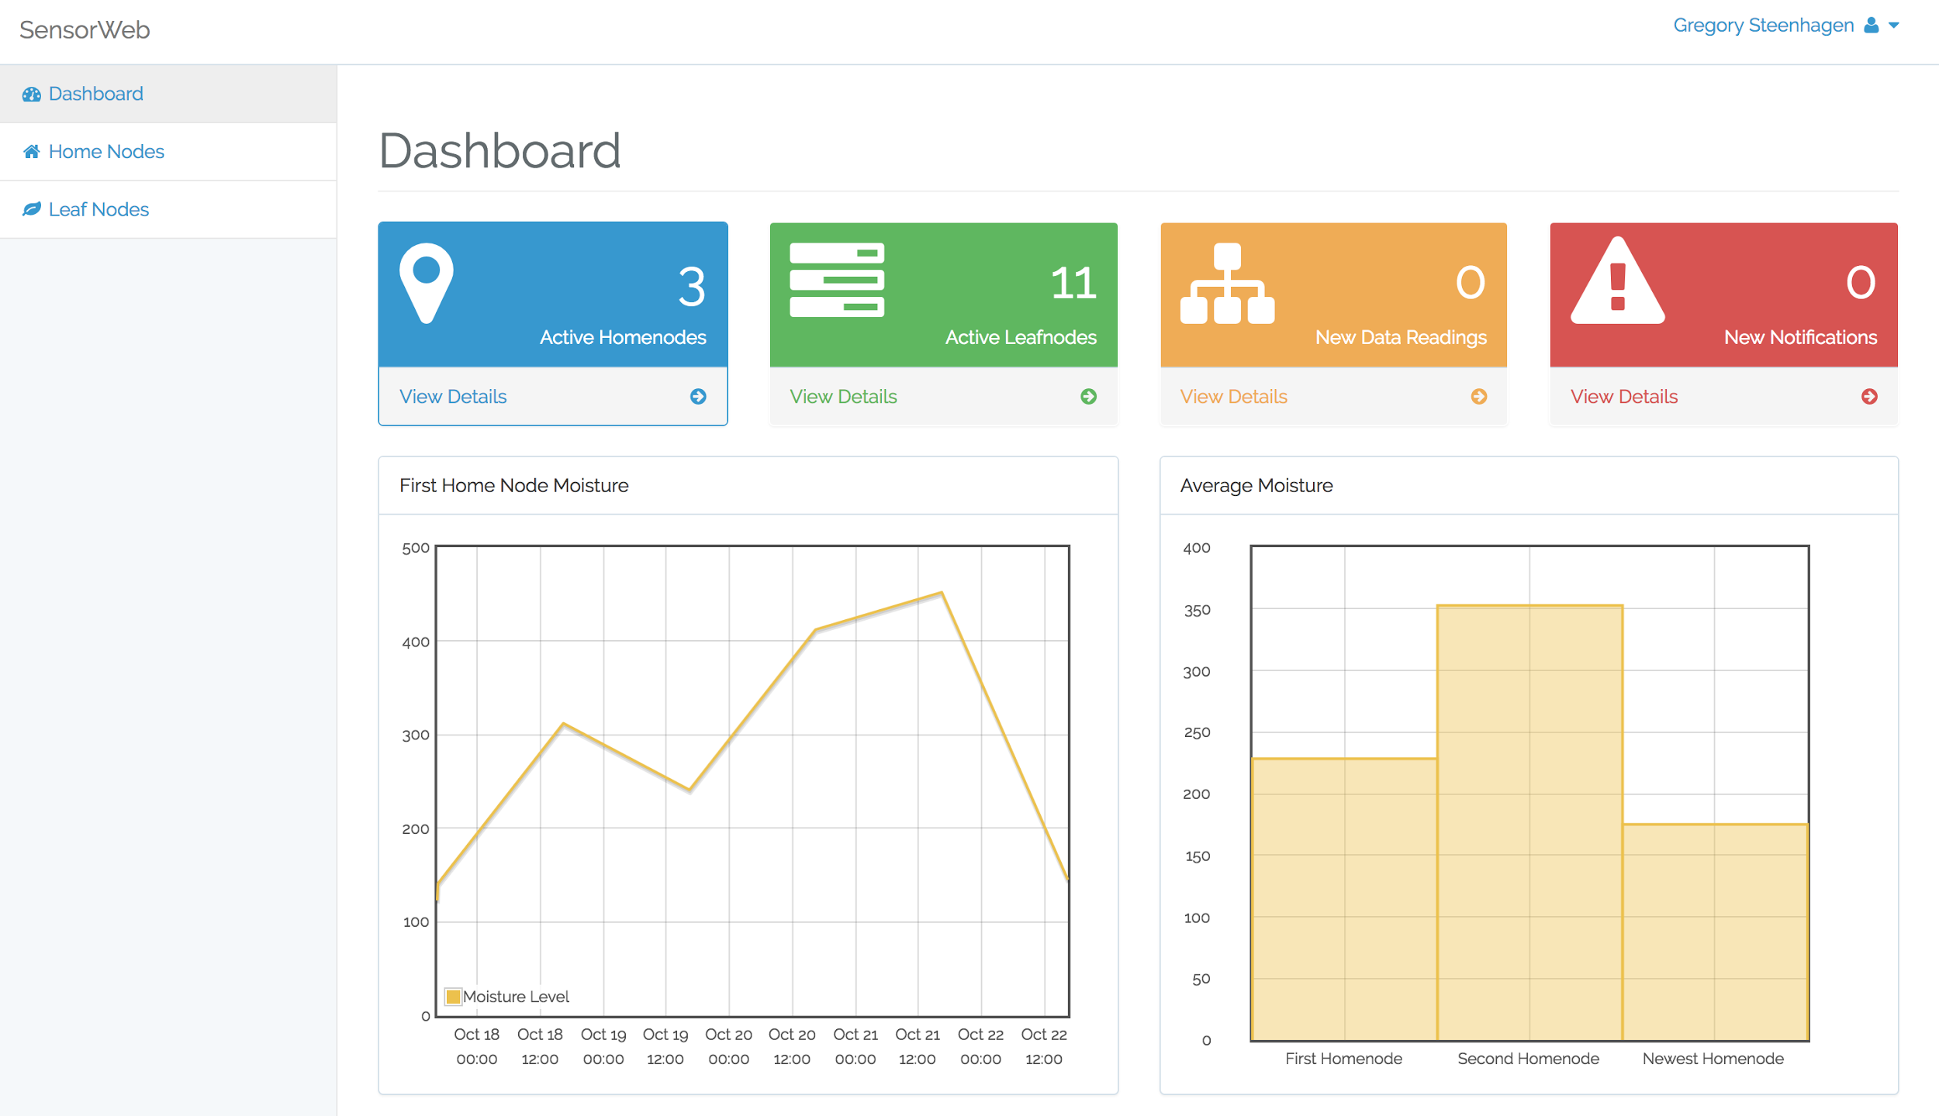
http://sensorweb.ece.iastate.edu
System Design:
Homenodes
Op. Nodes
Data Readings
Data Graphs
User Accounts
Notes:
Charlie:

Slide 19
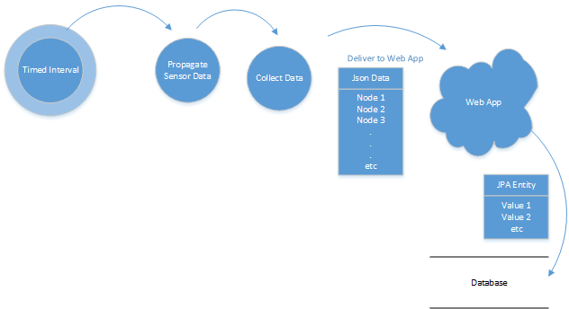
Interaction of Information
System Design:
Network Flow:
A timed interval requests data transfer
Data is collected by the home node
Information is posted via JSON
Data is stored using JDBC
Notes:
Ian: Here we have an information flow diagram. The transfer is triggered by our signal from the home node. During this event, the home node first gets the shortest paths for each node. Data is then collected for each node by following those paths. Data is then aggregated and posted for every node under the home node via json. This JSON string

Slide 20
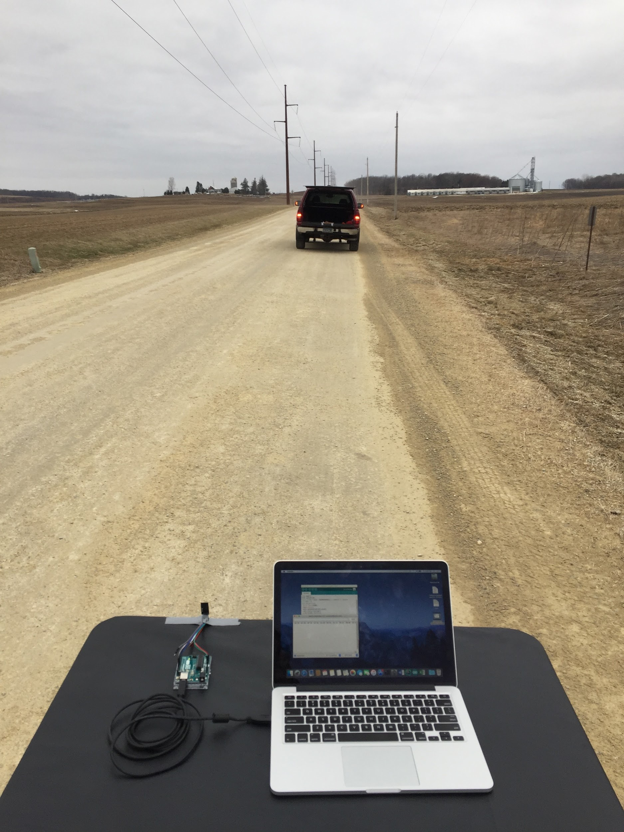
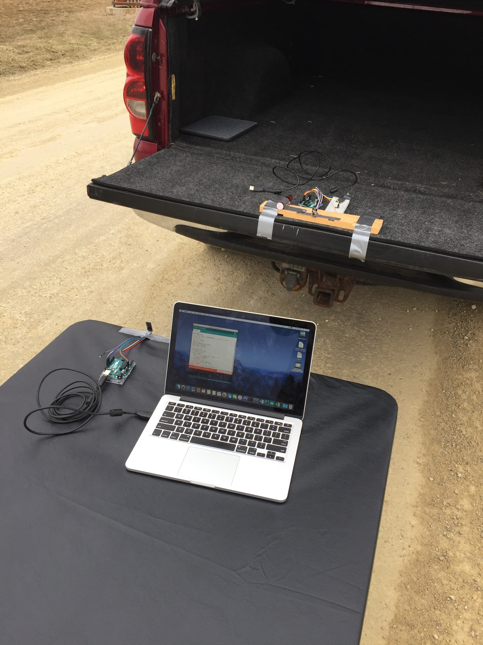
Node Testing
System Design:
System Design:
Range Experiment
Requirement: 1 node/acre=208ft/node
Receiver on table, transmitter in truck
Start/Stop coordinates recorded
Constant 10mph held by truck
Program Recorded signal integrity
Plotted as function of distance
Results
Short Range Transmitter ≈ 250ft
Long Range Transmitter ≈ 800ft
Increasing distance to receive
Range testing out on country road
Notes:
Tim:

Slide 21
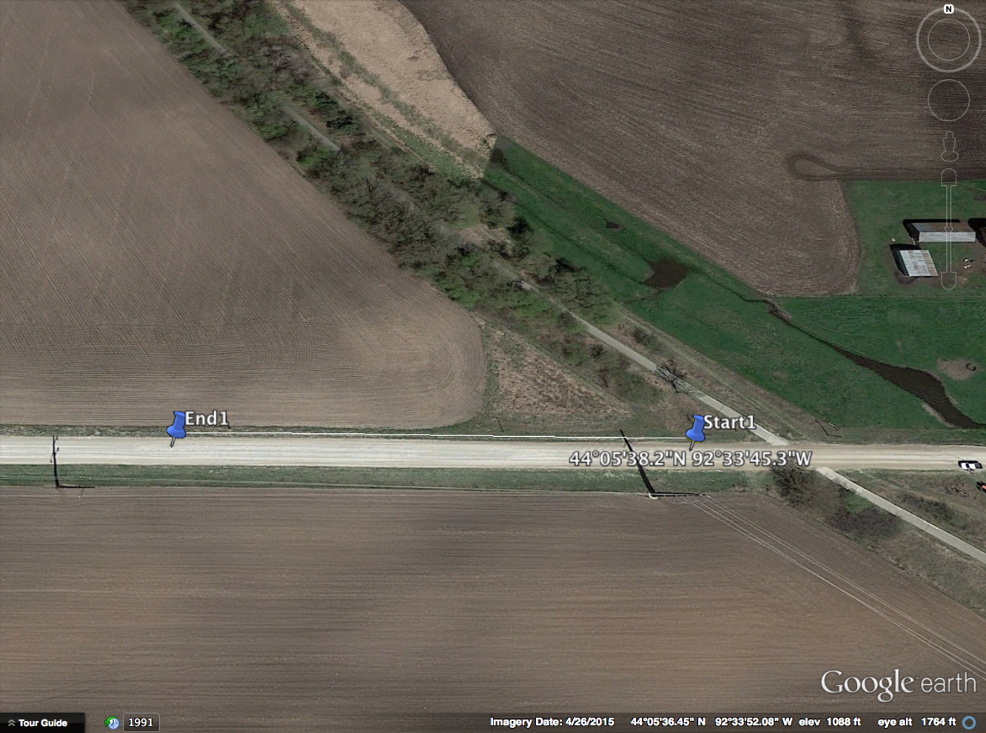
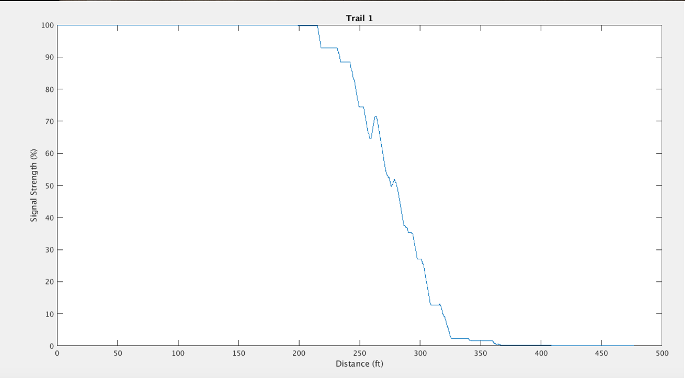
Notes:
Tim:
ANY QUESTIONS?????????

Slide 22
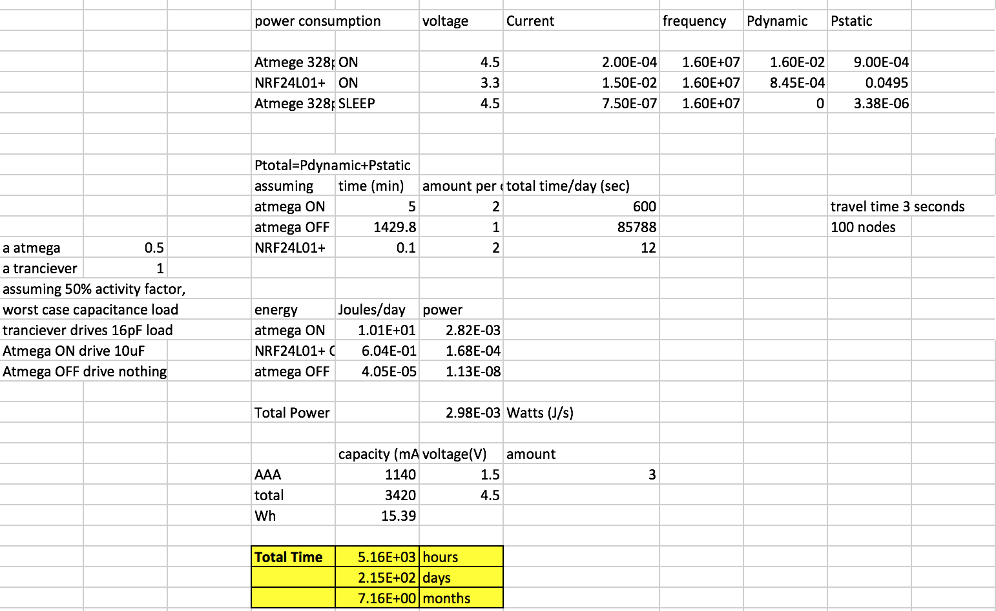
Op. Node Power and Cost Analysis
System Design:
Power Analysis
Cost Analysis
Notes:
Bulk Cost: average price reduction for buying 1000+ units was 40% which would get you to $7 a operational node.

Slide 23
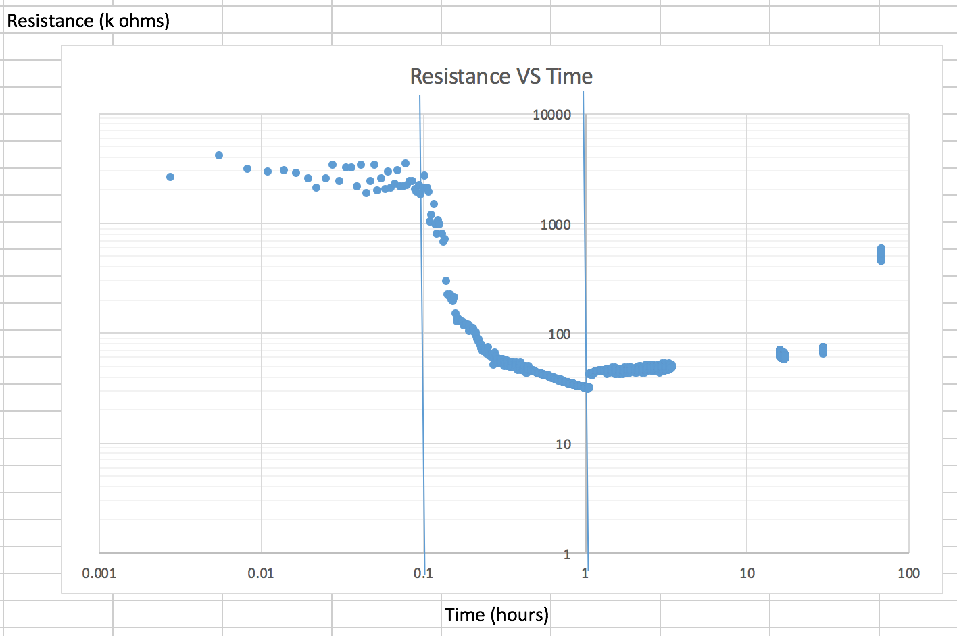
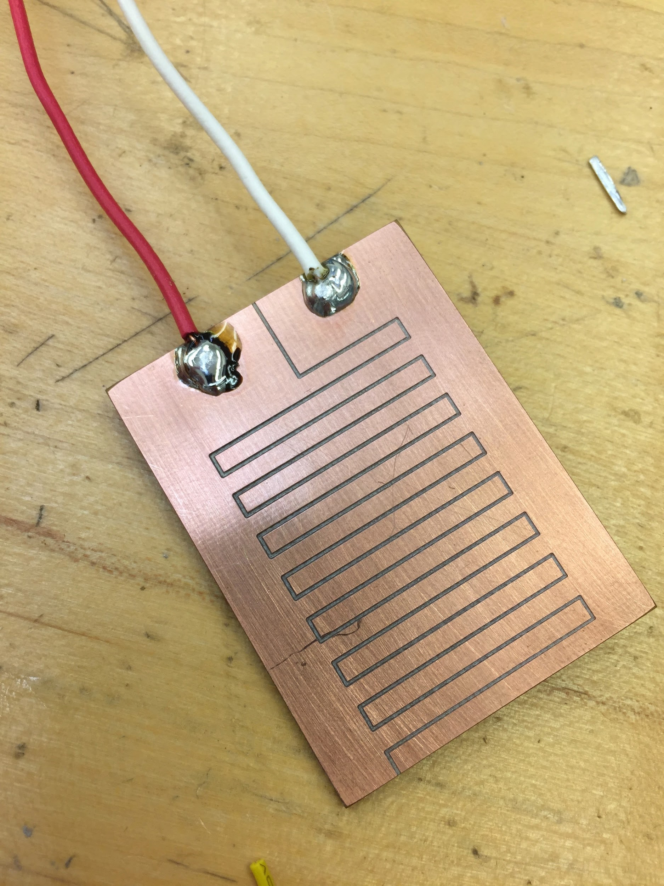
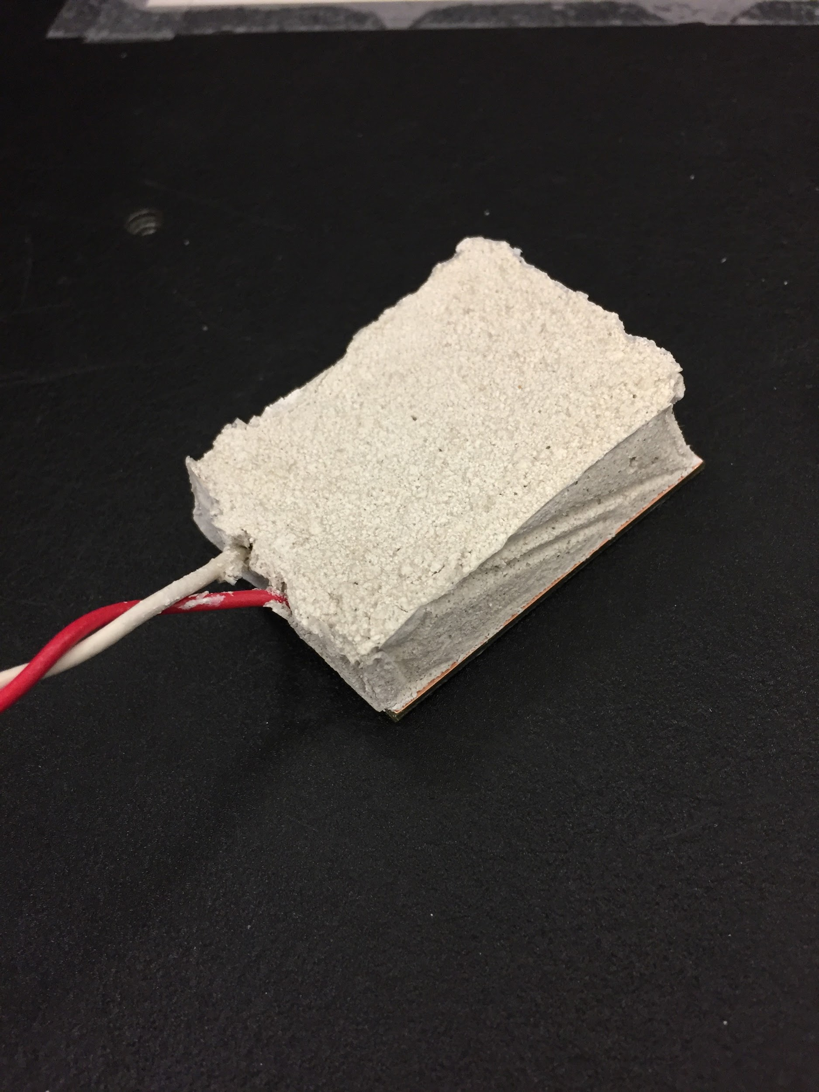
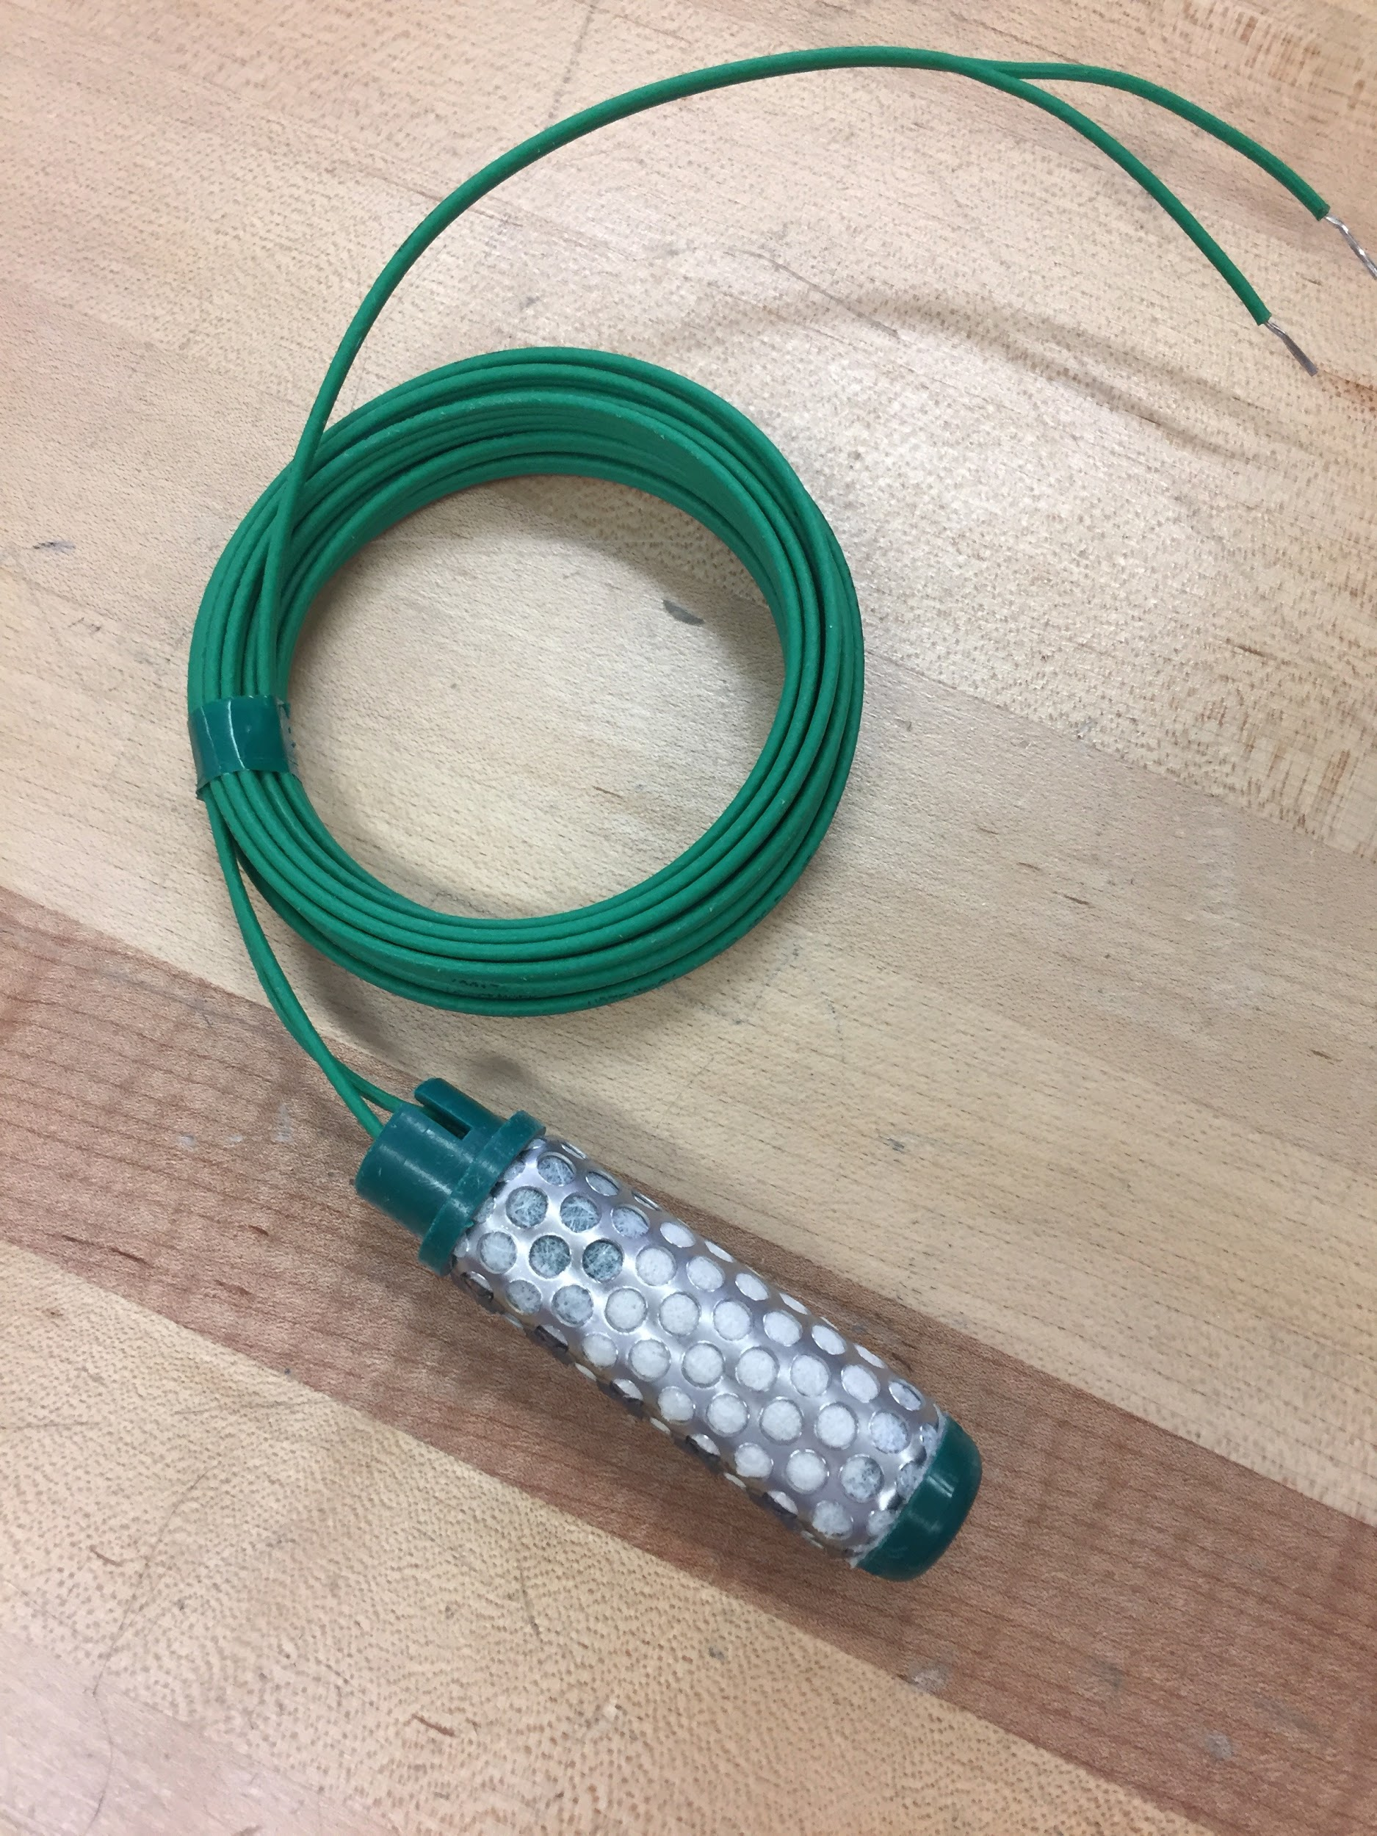
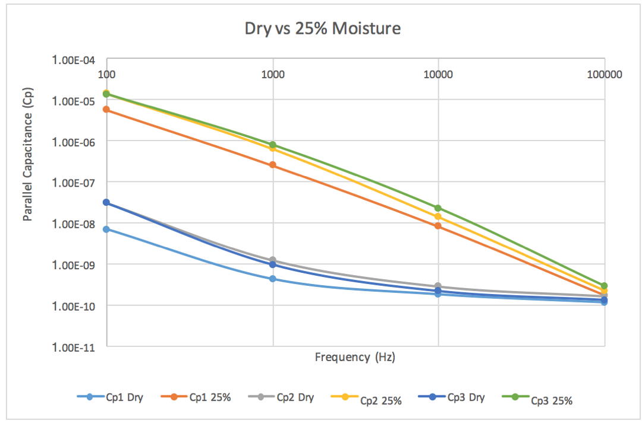
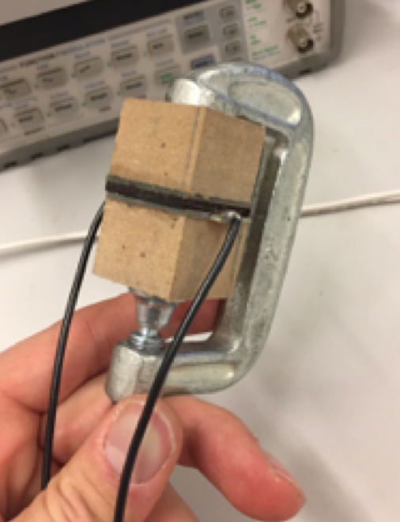
Sensor Solution
System Design:
System Design:
Preliminary Tests
Notes:
Tim:

Slide 24
Conclusion
Notes:
Ian:

Slide 25
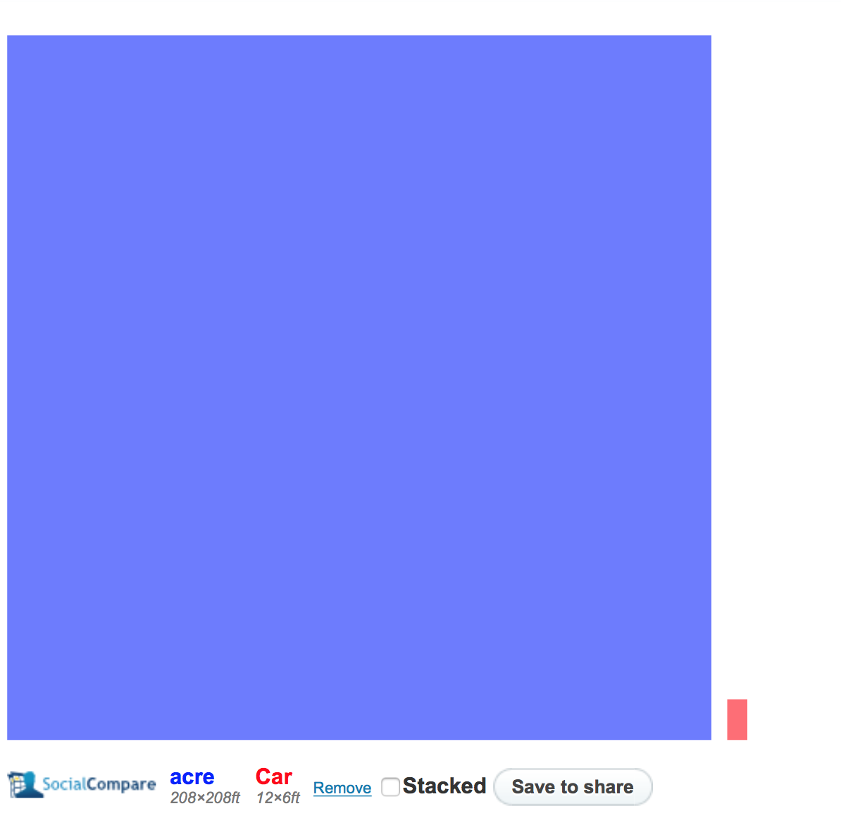
Independent Assessment
Conclusion:
Dr. Amy Kaleita-Forbes
Associate Professor in Agricultural and Biosystems Engineering
System and Website Input
Dan Bredbeck (11/1/17)
Applications Engineer at Certainteed Gypsum
Assessed our Gypsum Moisture Sensor Design
Dr. Sally Logsdon (12/1/17)
Soil Scientist at National Laboratory for Agriculture and the Environment
Assessed Sensor Web Solution
Notes:
Sally Logsdon:
Dynamic system to read more often during a rain, protection against mice and lightning, Sensitivity to polution
If asked about meeting with Dr. Amy Kaleita-Forbes:
Overview of field area, a heat map that shows the spread of field moisture
Organization by field/home node is good
Agreed that having high resolution over a large area is useful
Described radial sprinklers that can irrigate certain areas based on that information

Slide 26
Contributions & Roles:
Conclusion:
Ian Harris - Web Server Role, Team Leader
Gregory Steenhagen - Web Server Role, Webmaster
Tim Lindquist - Operational Node Role, Key Idea Holder
Steven Warren - Operational Node Role, Communication
Terver Ubwa - Home Node Role
Khoi Cao - Home Node Role
Notes:
Ian: Here our the contributions and roles for our project. Charlie and I covered the web application, Tim and Stephen constructed our Leaf nodes, and Terver and Khoi worked on the home node

Slide 27
Questions
Notes:
Ian: Thank you, any questions?

